Slide 1
Confirmatory Measurement Modeling
and Longitudinal Invariance
of the CompACT-15: A Short-Form Assessment of Psychological Flexibility
Ti Hsu¹, Lesa Hoffman², and Emily B.K. Thomas¹
University of Iowa
¹Department of Psychological and Brain Sciences
²Department of Psychological and Quantitative Foundations

Slide 2

Notes:
What kind of skills do we most want to promote in clients when they come in for a course of ACT?
Most ACT practitioners would say that we’d want to help our clients become more accepting of their thoughts and feelings, and more able to defuse from them (click for Openness).
They would also say that we’d want our client to become better at “being here, now”, and being able to step back and take perspective (click for Awareness)
And I bet the ACT therapists in this room would also want to help their clients become more able to pursue people, things, and causes that they value, even when time are tough (click for Engagement).

Slide 3
Openness
Notes:
What kind of skills do we most want to promote in clients when they come in for a course of ACT?
Most ACT practitioners would say that we’d want to help our clients become more accepting of their thoughts and feelings, and more able to defuse from them (click for Openness).
They would also say that we’d want our client to become better at “being here, now”, and being able to step back and take perspective (click for Awareness)
And I bet the ACT therapists in this room would also want to help their clients become more able to pursue people, things, and causes that they value, even when time are tough (click for Engagement).

Slide 4
Awareness
Openness
Notes:
What kind of skills do we most want to promote in clients when they come in for a course of ACT?
Most ACT practitioners would say that we’d want to help our clients become more accepting of their thoughts and feelings, and more able to defuse from them (click for Openness).
They would also say that we’d want our client to become better at “being here, now”, and being able to step back and take perspective (click for Awareness)
And I bet the ACT therapists in this room would also want to help their clients become more able to pursue people, things, and causes that they value, even when time are tough (click for Engagement).

Slide 5
Awareness
Openness
Engagement
Notes:
What kind of skills do we most want to promote in clients when they come in for a course of ACT?
Most ACT practitioners would say that we’d want to help our clients become more accepting of their thoughts and feelings, and more able to defuse from them (click for Openness).
They would also say that we’d want our client to become better at “being here, now”, and being able to step back and take perspective (click for Awareness)
And I bet the ACT therapists in this room would also want to help their clients become more able to pursue people, things, and causes that they value, even when time are tough (click for Engagement).

Slide 6
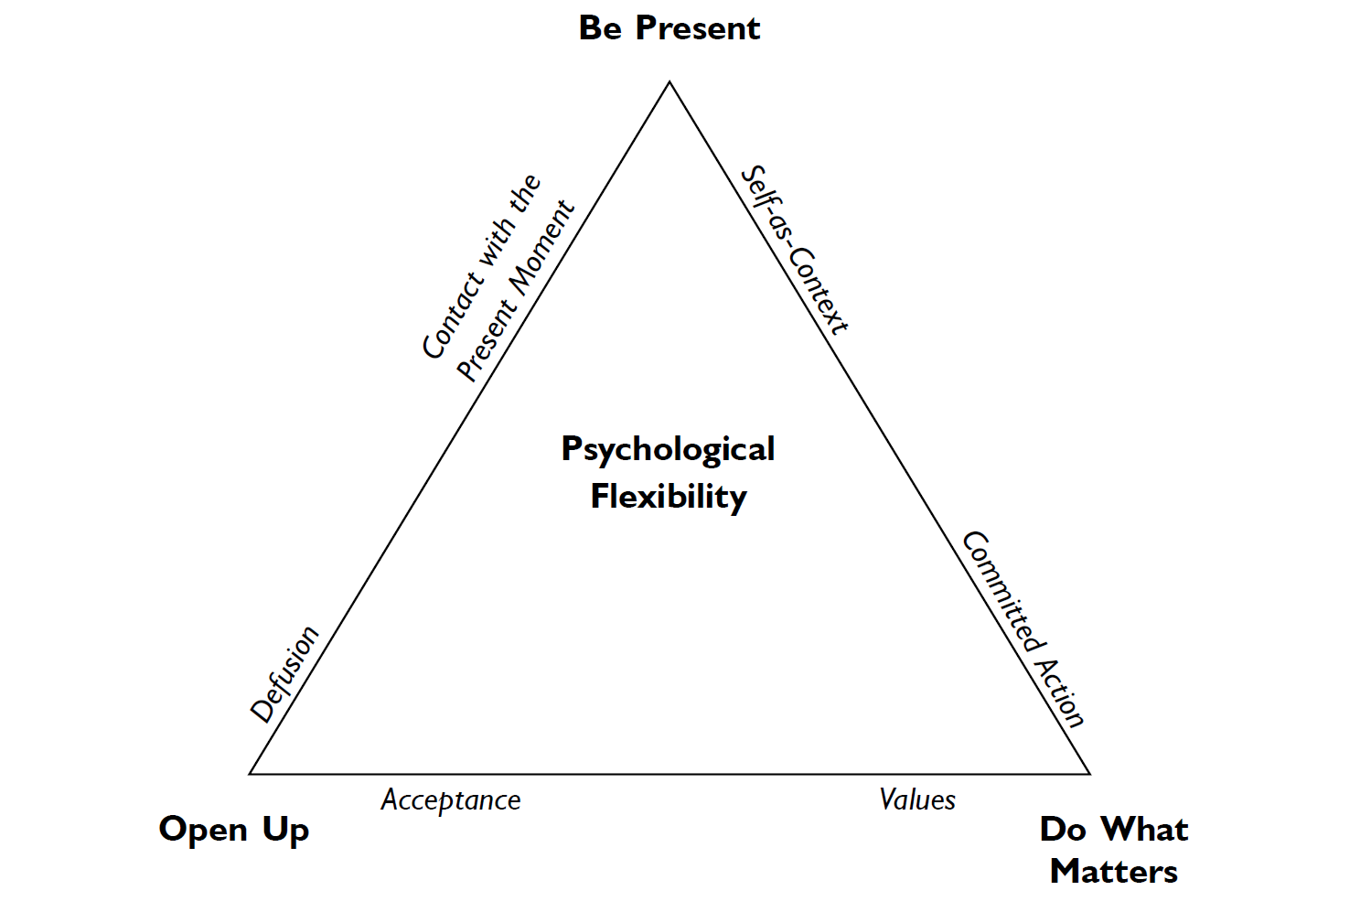
Harris, 2021
Notes:
These three sets of skills are subsumed under a more general psychological construct that we refer to as: “psychological flexibility” or PF in this talk for short.
ACT is theorized to increase a client’s PF, and a whole host of studies have shown that these increases in PF are associated with decreases in symptoms of psychopathology, including anxiety, depression, OCD, and eating disorders.
Since this construct is central to ACT and contextual behavioral science, it is essential that we have reliable and valid instruments with which to measure it.

Slide 7
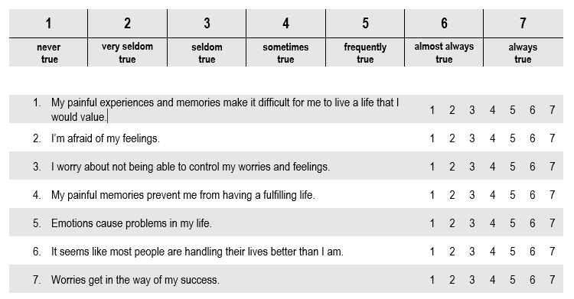

Unidimensional Measurement of PF
The Acceptance and Action Questionnaire-II (Bond et al., 2011).
Notes:
One common measure of PF is the Acceptance and Action Questionnaire-II, which indirectly assesses PF with 7 items which actually assess psychological inflexibility, or experiential avoidance.

Slide 8
Strengths
Weaknesses
Bond et al., 2011
  Well-fitting 1 factor structure after addition of residual variance
  Good alpha reliability
  Construct validity
Fledderus et al., 2012
  Replicated 1 factor structure
  Incremental validity
  No DIF by gender
Flynn et al., 2016
  Marginal fit for 1 factor structure after addition of residual variance
  Incremental validity
Wolgast., 2014
  AAQ-II items more strongly related to items measuring distress rather than acceptance/nonacceptance
Tyndall et al., 2019
  AAQ-II factor more strongly related to internalizing symptoms and stress than other measure of PF
Rochefort et al., 2018
  AAQ-II items also measure neuroticism and negative affect
Notes:
The AAQ-II has been used and studied extensively, and studies have elaborated on both its strengths and weaknesses. Notably, even in papers which have provided well-fitting models assessing the AAQ-II’s dimensionality, these well-fitting models have been arrived at only with the addition of residual variances among items which mention painful experiences.
Furthermore, when examined in tandem with measures assessing distress, the AAQ-II has demonstrated modest associations with those measures, which elicits questions regarding the instrument’s construct validity. That is—is the AAQ-II measuring psychological inflexibility, or is it more of a measure of distress?
As I alluded to earlier, the wording of the AAQ-II also directly assesses psychological inflexibility, or experiential avoidance.
This is problematic because, while PF and PIF have been theorized to be inverses of each other, here is some recent evidence which suggest that PF and PiF may not lie on the same continuum.
Furthermore, there is other work demonstrating how it is problematic to measure a positive construct through the absence of a negative construct.
Lastly, the AAQ-II items assess PF as though it were a unidimensional construct, but in theory PF is multi-faceted.

Slide 9
Multidimensional Experiential Avoidance Questionnaire (MEAQ; Gámez et al., 2011)—62 items.
Multidimensional Psychological Flexibility Inventory (MPFI; Rolffs et al., 2016)—60 items.
Psy-Flex (Gloster et al., 2021)—6 items.
Comprehensive assessment of Acceptance and Commitment Therapy processes (CompACT; Francis et al., 2016)—23 items.
Multidimensional
Measurement of PF
Notes:
Several instruments have been developed with the multidimensional nature of PF in mind, among them are the MEAQ, MPFI, the PsyFlex, and the Comprehensive assessment of Acceptance and Commitment Therapy Processes, or the CompACT.

Slide 10
23-item measure with a three-factor structure:
  Openness to Experience
  Behavioral Awareness,
  Valued Action.
Has demonstrated acceptable psychometrics:
  Acceptable alpha reliability
  Construct validity when examined with internalizing symptoms and well-being.
Relative brevity compared to other multidimensional PF measures.
The CompACT
Notes:
The CompACT assesses the PF Tri-Flex with three subscales—Behavioral Awareness, Valued Action, and Openness to Experience.
Previous psychometric work on the CompACT has demonstrated acceptable reliability as assessed through Cronbach’s alpha, and construct validity when examined with internalizing symptoms and well-being. Another major strength of the CompACT is its relative brevity compared to most other multidimensional PF measures.

Slide 11
Dimensionality has only been assessed through exploratory factor analysis (EFA).
Reliability has been largely assessed through coefficient alpha, which makes 3 untested assumptions about the items.
Stability over time of the CompACT items has not yet been formally examined.
Psychometric Limitations
Notes:
However, the CompACT also faces some psychometric limitations.
First, the dimensionality of the CompACT has mainly been assessed through exploratory factor analysis (EFA). ), in which all 23 items were specified as measuring all three latent factors and the fit of the factors were not tested.
Second, the reliability of the CompACT has been assessed mainly with Cronbach’s alpha, which rests upon three untested assumptions—unidimensionality, equal discrimination, and no residual correlations.
Last, the stability over time of the CompACT items has not yet been formally examined.

Slide 12
Study Aims
Assess the dimensionality of the CompACT with both Confirmatory Factor Analysis (CFA) and Item Factor Analysis (IFA).
Assess the model-based reliability of the CompACT.
Further assess the construct validity of the CompACT by examining the association between the 3 factors and related constructs.
To examine the measurement equivalence of the CompACT over the span of three months.
Notes:
To address these limitations, the current study had three aims.
First, it aimed to assess the dimensionality of the CompACT with two kinds of confirmatory latent variable models—confirmatory factor analysis and item factor analysis. Unlike EFA, these models provide empirical tests of theoretically drive factor structures which capture common content or characteristics.
With our confirmatory measurement models, we aimed to provide model-based estimates of reliability that more accurately reflect characteristics of items measuring latent factors—namely, we will assess reliability with McDonald’s omega.
Last, we will examine measure equivalence over time in the CompACT to address the extent to which longitudinal changes reflect true changes in latent factors, rather than artificial variation created by changed in how items relate to factors over time.

Slide 13
Method: Procedure
Data were part of a larger longitudinal MTurk study examining coping strategies, risk factors, and psychiatric symptoms during COVID-19.
Inclusion criteria included being a United States resident; fluency in English; age ≥ 18 years; and previous completion of ≥ 100 Human Intelligence Tasks (HITs) with an approval rate ≥ 95%.
Several validity and attention checks were included in surveys to reduce inattentive, straight-line, or automated responding.
Notes:
Our data were part of a larger longitudinal Mturk study examining various psychological factors in the context of COVID-19. These data were collected between May and July of 2020.
Our inclusion criteria and validity and attention checks were all designed to safeguard data quality.

Slide 14


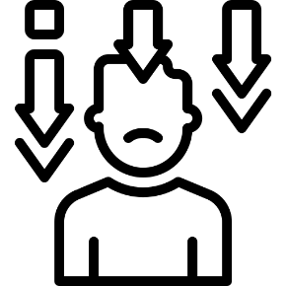
Method: Participants
Recruited via Mturk
78.1% White
82.9% non-Hispanic
59.6% Male
86.5% Heterosexual
67.3% Employed full time
Mean Age = 37.42 (SD = 11.46)
N = 523
T0 (May 2020); n = 485
T1 (June 2020); n = 360
T2 (July 2020); n = 266
Completion of all three surveys were not related to race, sex, or employment.
Completers more likely to identify as Hispanic/Latino at T1 and T2.
Completers more likely to identify as heterosexual at T2.
Notes:
We ran analyses to examine differences between completers and non-completers, but for the sake of time I won’t review them today.

Slide 15
The 23-item CompACT
(Francis et al., 2016).
The 7-item AAQ-II
(Bond et al., 2011)
The 6-item Brief Resilience Scale
(BRS; Smith et al., 2008)
The 12-item Intolerance of Uncertainty Scale-12 (IUS-12; Carleton et al., 2007)
The 10-item Kessler Psychological Distress Scale (K10; Kessler et al., 2002)
Method: Measures
Notes:
Introduce these measures briefly and their relation with the CompACT. Highlight the AAQ-II. These were the measures employed in the current study.

Slide 16
Method: Analytic Strategy
Confirmatory Factor Analysis
Item Factor Analysis/IRT
Predict a continuous, normally distributed item response for at least one latent factor score.
Parameters: item intercept, factor loading, and residual variance.
Factor means and variances set to 0 and 1 respectively to estimate all parameters.
Robust full-information maximum likelihood (MLR) used to estimate all CFA models.
Predict the probability of each of K total response options using a cumulative link function and K-1 binary submodels.
Parameters: all submodels for an item share 1 factor loading, but each submodel has their own threshold.
We also converted IFA parameters into IRT parameters of difficulty and discrimination.
Diagonally weighted least squares (WLSMV with a THETA parameterization that fixed item residual variances to 1) used to estimate all IFA models.
Notes:
Since the CompACT items are rated on a 7-point Likert scale, we employed both CFA and IFA/IRT frameworks for our models. I provided a summary of differences between these two methods and my slides will be available, but the main difference is continuous vs discrete item response assumptions.

Slide 17
Results: Dimensionality and Scale Revision
We first tested the extent to which covariances between items of the 23-item CompACT at T0 could be predicted by the 3 hypothesized factors (i.e., OE, BA, and VA)
Found poor model fit by every index using both CFA and IFA.
Three design issues may have contributed to model misfit:
  Uneven use of positive or negative wording across factors,
  Redundancy in content,
  Interpretability of item content (e.g., “thoughts are just thoughts”).
Notes:
We then explored ad-hoc model revisions to improve model misfit
We found that acceptable model fit for all 23 items could only be achieved at the expense of parsimony and interpretability.

Slide 18
Notes:
Negatively keyed items are highlighted

Slide 20
Notes:
Difficult to interpret or redundant items are highlighted

Slide 21
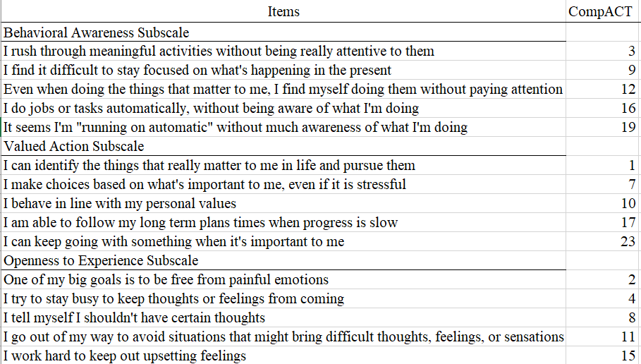
The CompACT-15
Notes:
We then pursued an alternative strategy—to develop a more balanced and cohesive short form by eliminating some items and addressing these design issues.

Slide 22
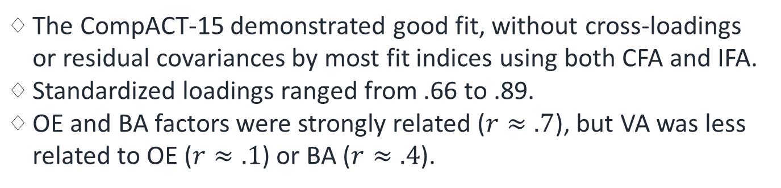
Results: CompACT-15 Dimensionality
The CompACT-15 demonstrated good fit, without cross-loadings or residual covariances by most fit indices using both CFA and IFA.
Standardized loadings ranged from .66 to .89.
OE and BA factors were strongly related ($r≈.7$), but VA was less related to OE ($r≈.1$) or BA ($r≈.4$).

Slide 23
Results: Model-based Reliability in Three Ways
1. Omega reliability for each dimension:
  .850 for OE
  .929 for BA
  .851 for VA
2. Factor reliability as the proportion of true trait variance for each factor score over the total variance:
  .886 for OE
  .940 for BA
  .878 for VA
3. Item information/(Item information +1)
Notes:
We assessed model-based reliability in three ways. First, we calculated omega reliability for each dimension. Second, we calculated factor reliability as the proportion of true trait variance for each factor score over total variance. As you can see, all three models demonstrated acceptable reliability.
Before moving on to our third model-based reliability metric, we will examine item response characteristics in both the CFA and IFA/IRT frameworks.

Slide 24
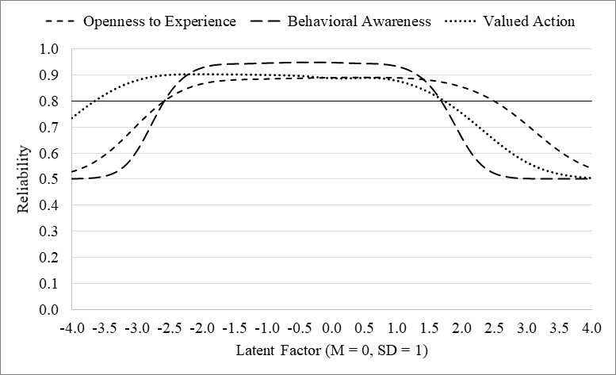
Notes:
This figure depicts total information using a reliability metric of 0–1 as computed from: information / (information + 1).
Each dimension had reliability > .80 for persons with mid-range factor scores (i.e., −2.6 SD to 1.7 SD), with relatively greater reliability for behavioral awareness in this mid-range. Reliability was relatively higher at lower factor scores for valued action and at higher factor scores for openness to experience

Slide 25
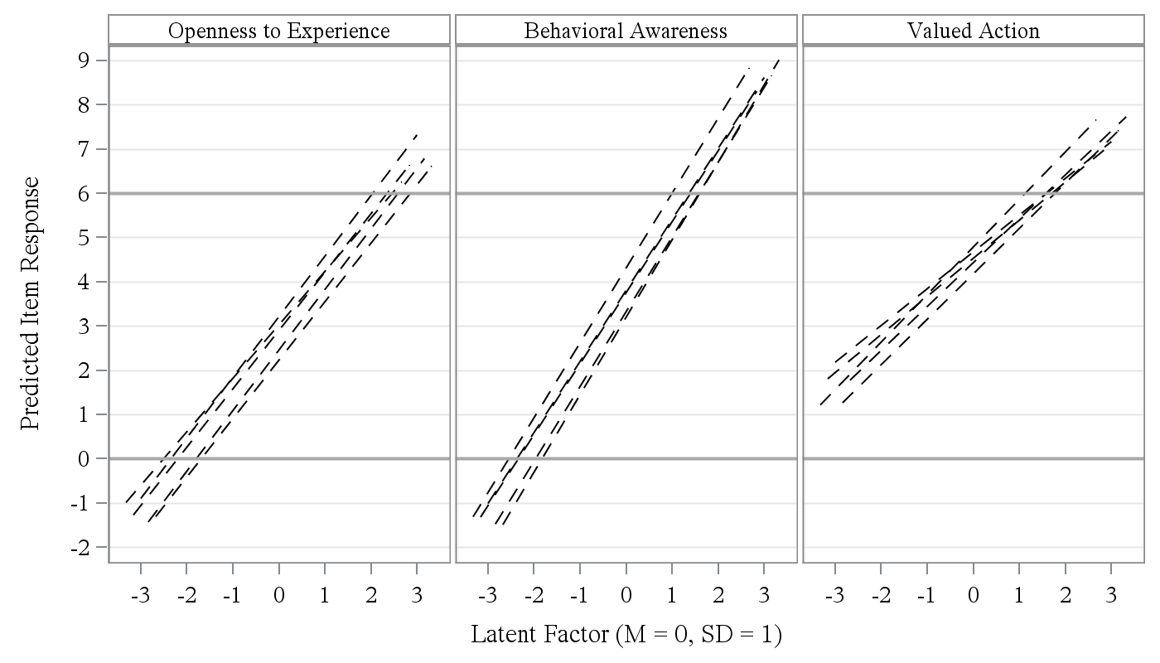
Notes:
These are CFA-predicted item responses for factor scores within 3 standard deviations of the mean. A linear slope does not seem to be adequate for many items, as evidenced from their impossible predicted responses, specially for BA, but also for OE and VA.

Slide 26
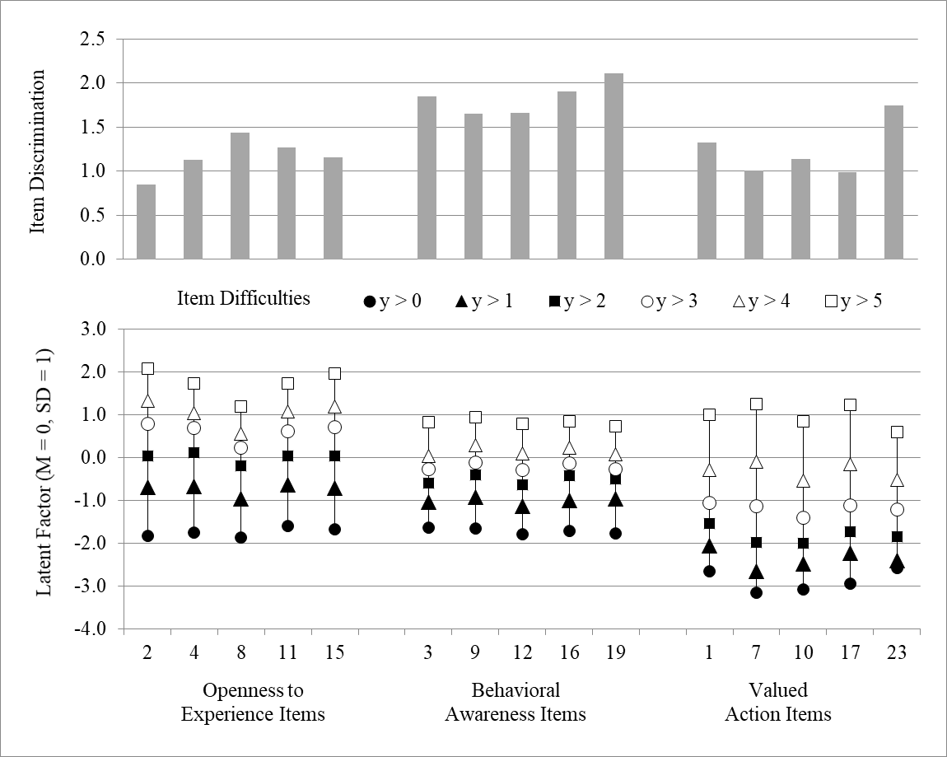
Notes:
we turn to the results of the IFA/IRT models, whose nonlinear slopes constrain the predicted item responses to their possible discrete options.
This figure shows each item’s IRT discrimination and difficulty estimates.
The variability in how well-differentiated each response category appears across items suggests that a response format with fewer middle categories may be sufficient, but which categories may be omitted also appears to depend on item wording.

Slide 27
Results: Measurement Stability Over Time
Used longitudinal measurement invariance procedures in which unstandardized factor loadings, intercepts or thresholds, and residual variances were constrained equal over time in successive models.
Resulting decreases in global fit were examined using nested model comparisons.
Majority of item parameters functioned equivalently across three occasions, separated by 1-month intervals.
This is to be expected in a non-treatment setting in which minimal true change or reactivity is likely.

Slide 28
Results: Construct Validity
All CFA correlations were significant at the p < .001 level except between Prospective Anxiety and Valued Action (p = .033), between positively-worded BRS items and Behavioral Awareness (p = .003), and between Openness to Experience and Valued Action (p = .042).
All IFA correlations were significant at the p < .001 level.
Notes:
As we can see from both the CFA and IFA correlations (CFA correlations are above the diagonal, while the IFA ones are below the diagonal), the CompACT-15 dimensions show expected patterns of correlation to support construct validity. Notably, when compared to the AAQ-II, which had extremely high correlations with the k-10, a measure of distress, the CompACT-15 had notably weaker correlations with distress.
Highlight k-10 correlations.

Slide 29
Results: Construct Validity
All CFA correlations were significant at the p < .001 level except between Prospective Anxiety and Valued Action (p = .033), between positively-worded BRS items and Behavioral Awareness (p = .003), and between Openness to Experience and Valued Action (p = .042).
All IFA correlations were significant at the p < .001 level.
Notes:
As we can see from both the CFA and IFA correlations (CFA correlations are above the diagonal, while the IFA ones are below the diagonal), the CompACT-15 dimensions show expected patterns of correlation to support construct validity. Notably, when compared to the AAQ-II, which had extremely high correlations with the k-10, a measure of distress, the CompACT-15 had notably weaker correlations with distress.

Slide 30
Results: Construct Validity
All CFA correlations were significant at the p < .001 level except between Prospective Anxiety and Valued Action (p = .033), between positively-worded BRS items and Behavioral Awareness (p = .003), and between Openness to Experience and Valued Action (p = .042).
All IFA correlations were significant at the p < .001 level.
Notes:
As we can see from both the CFA and IFA correlations (CFA correlations are above the diagonal, while the IFA ones are below the diagonal), the CompACT-15 dimensions show expected patterns of correlation to support construct validity. Notably, when compared to the AAQ-II, which had extremely high correlations with the k-10, a measure of distress, the CompACT-15 had notably weaker correlations with distress.

Slide 31
In Sum…
We propose a new short-form of the CompACT, the CompACT-15, which demonstrates good model fit of a correlated 3 factor model with simple structure and adequate reliability.
Majority of CompACT-15 items demonstrated measurement stability across three occasions in a two-month period.
CompACT-15 dimensions also show expected patterns of correlation to support construct validity.

Slide 32
Study Limitations
Recruitment of respondents using Mturk, which has been subject to scrutiny due to increased activity from bots and farmers.
  Followed recommendations for best practice to safeguard data quality (Chemielewski & Kucker, 2020).
Reported influx of new MTurk respondents during the COVID-19 pandemic who are less cognitively reflective, White, Democratic, and experienced compared to respondents prior to the pandemic (Arechar & Rand, 2021).
  Unclear what effects this more diverse but less attentive subject pool may have on data quality.

Slide 33
Study Strengths and Future Directions
Our use of two different types of confirmatory measurement models (CFA and IFA/IRT).
The brevity of the CompACT-15—shorter instrument with better model fit and good reliability.
Highlight the importance of wording direction in items which measure PF—PF is not just the inverse of psychological inflexibility. Future examination of different kinds of measurement equivalence needed.
Notes:
One possible explanation is that OE and BA are more strongly correlated is because they’re on one side of the hexaflex and VA is on the other.
Examine the measurement equivalence of the CompACT-15 in individuals receiving psychotherapy and those who are not.
Examine the measurement equivalence of the CompACT-15 across longer (or shorter!) temporal contexts.
Examine the measurement equivalence of the CompACT-15 across different cultural groups.

Slide 34
Notes:
As we can see from both the CFA and IFA correlations (CFA correlations are above the diagonal, while the IFA ones are below the diagonal), the CompACT-15 dimensions show expected patterns of correlation to support construct validity. Notably, when compared to the AAQ-II, which had extremely high correlations with the k-10, a measure of distress, the CompACT-15 had notably weaker correlations with distress.
Highlight k-10 correlations.

Slide 35
Study Strengths and Future Directions
Our use of two different types of confirmatory measurement models (CFA and IFA/IRT).
The brevity of the CompACT-15—shorter instrument with better model fit and good reliability.
Highlight the importance of wording direction in items which measure PF—PF is not just the inverse of psychological inflexibility.
Future examination of different kinds of measurement equivalence needed.
Notes:
One possible explanation is that OE and BA are more strongly correlated is because they’re on one side of the hexaflex and VA is on the other.
Examine the measurement equivalence of the CompACT-15 in individuals receiving psychotherapy and those who are not.
Examine the measurement equivalence of the CompACT-15 across longer (or shorter!) temporal contexts.
Examine the measurement equivalence of the CompACT-15 across different cultural groups.

Slide 36

Acknowledgements
Dr. Lesa Hoffman and Dr. Emily Thomas
The creators of the CompACT, Dr. Ashley Francis, Dr. David Dawson, and Dr. Nima Golijani-Moghaddam
The THRIVE Lab, especially Dr. Anne Roche, Jenna Adamowicz, M.A., and Manny Stegall, B.S.
University Iowa Graduate College
University of Iowa Graduate and Professional Student Government

Slide 37
Thank you for listening!
Any questions?
You can also reach me at:
ti-hsu@uiowa.edu,
@TiHsu1

Slide 38
Pocket Slides

Slide 39
More on the AAQ-II
Wording directly assesses EA or PiF, not PF.
  Evidence that PF and PiF may not lie on the same continuum.
  Positive construct should not be measured through the absence of a negative construct.
AAQ-II items measure PiF as a unidimensional construct, but PF is in theory multidimensional.
Notes:
As I alluded to earlier, the wording of the AAQ-II also directly assesses psychological inflexibility, or experiential avoidance.
This is problematic because, while PF and PIF have been theorized to be inverses of each other, here is some recent evidence which suggest that PF and PiF may not lie on the same continuum.
Furthermore, there is other work demonstrating how it is problematic to measure a positive construct through the absence of a negative construct.
Lastly, the AAQ-II items assess PF as though it were a unidimensional construct, but in theory PF is multi-facted.

Slide 40
Study Strengths II
Our results also highlight the importance of wording direction in items which measure PF.
We show that negatively-keyed items do not function as the unidimensional opposite of positively keyed items, since we observed lower correlations with the positively worded VA items with the negatively worded OE and BA items.
We also observed larger correlations among CompACT-15 factors and those measured by similarly worded items.
PiF is not the inverse of PF!

Slide 41
Future Directions
Examine
Examine the measurement equivalence of the CompACT-15 in individuals receiving psychotherapy and those who are not.
Examine
Examine the measurement equivalence of the CompACT-15 across longer (or shorter!) temporal contexts.
Examine
Examine the measurement equivalence of the CompACT-15 across different cultural groups.

